Slide 1
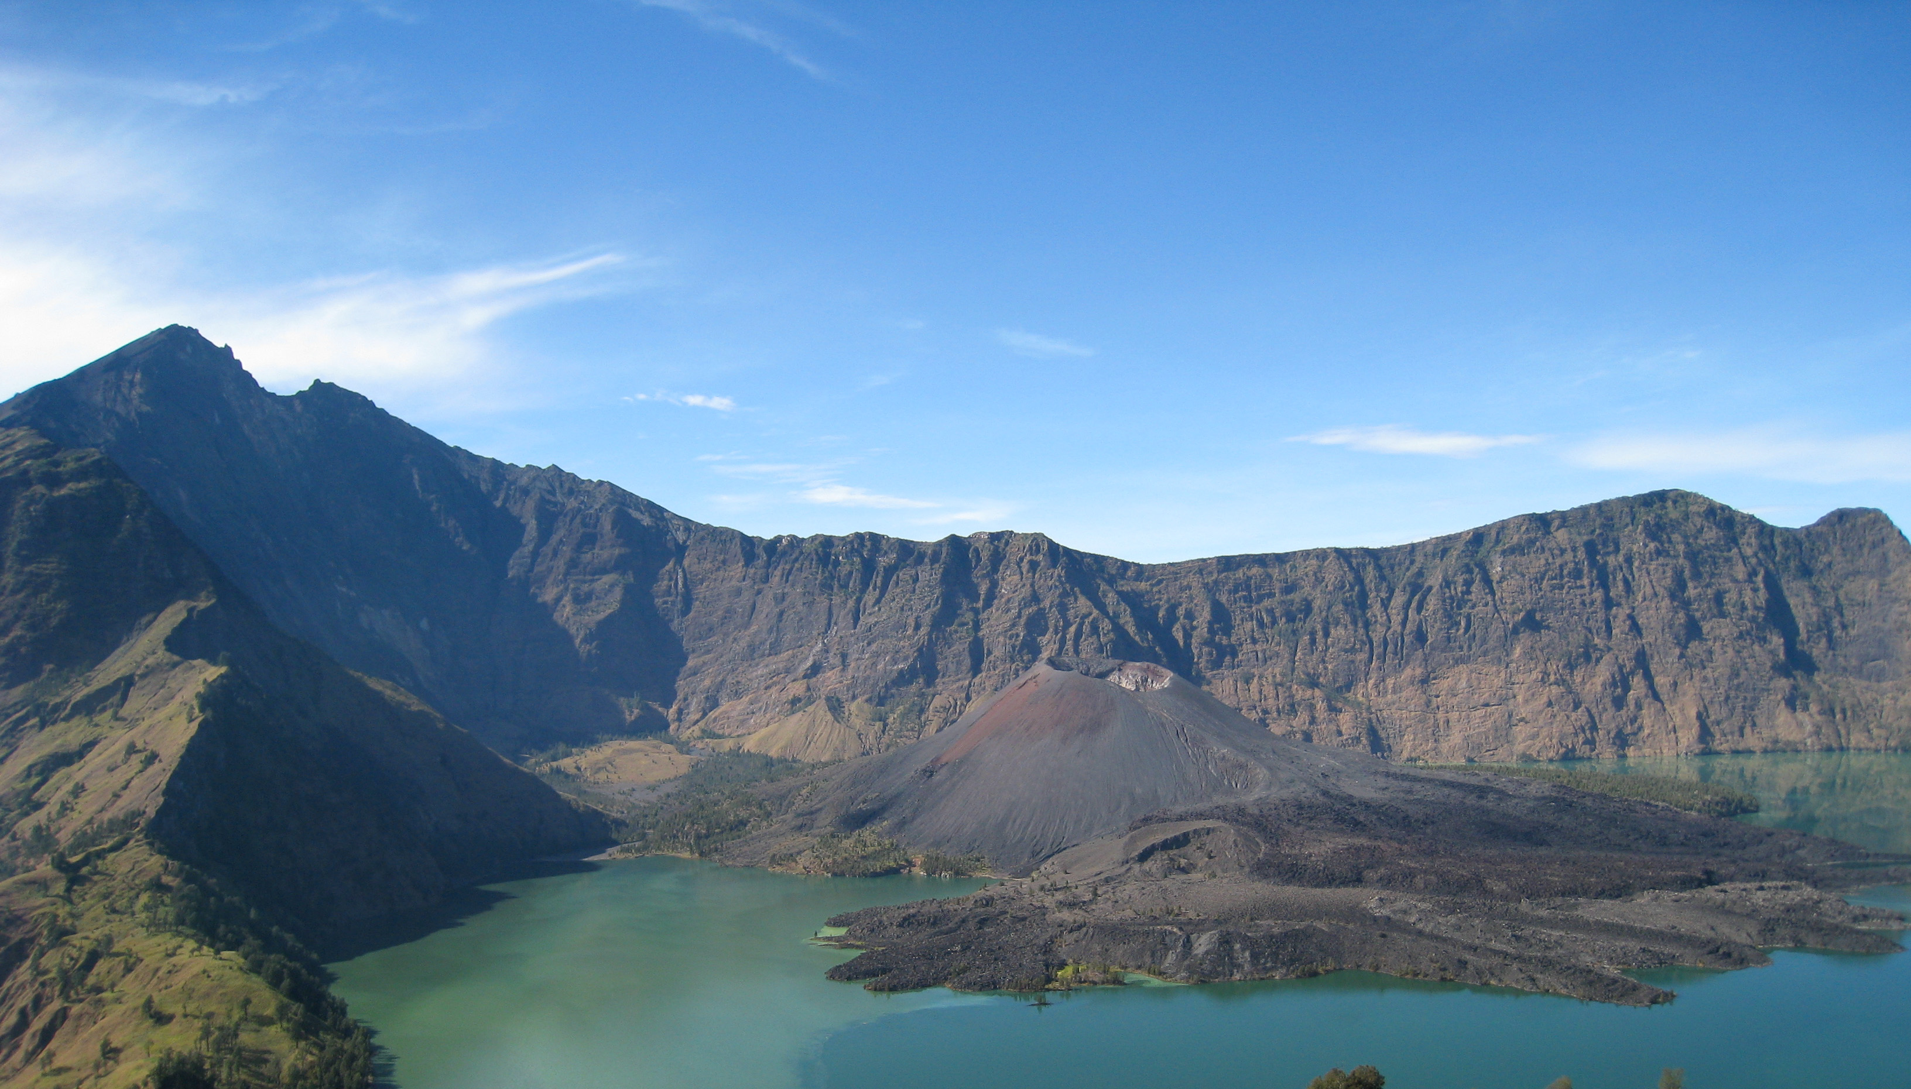
Constraining the Timing of the 1257 Samalas Eruption: a Model and Multi-proxy Approach
Laura Wainman*¹, Lauren Marshall², Anja Schmidt^{2,3}
¹Department of Earth Sciences, University of Cambridge, United Kingdom
²Department of Chemistry, University of Cambridge, United Kingdom
³Department of Geography, University of Cambridge, United Kingdom
*lw602@cam.ac.uk
Notes:
Hello, I’m Laura Wainman, a fourth year Earth Sciences Student at the University of Cambridge. Today I’m going to be talking about a section of work from my Masters project…

Slide 2
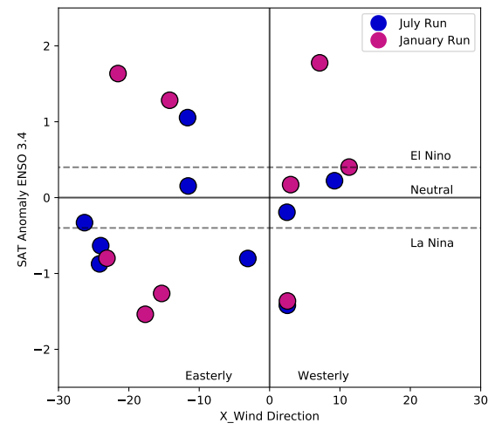
+ Proxy data
Objectives + Methodology
Research Objectives
UK Earth System Model
Historical sources
Tree Rings
Stalagmites
[1] Eruption Timing
[2] Prior-atmospheric conditions (QBO/ENSO)
[3] Atmospheric Response (ENSO)
ENSO: El Niño Southern Oscillation
QBO: Quasi-Biennial Oscillation
Constraining the Timing of the 1257 Samalas Eruption: a Model and Multi-proxy Approach lw602@cam.ac.uk
Notes:
The Samalas 1257 Eruption was the largest eruption of the common era, injecting an estimated 120Tg into the Stratosphere. The objectives of this project are to place additional constraints on eruption timing, the atmospheric conditions that may have prevailed at the time of the eruption, and how atmospheric modes may have responded following the eruption, particularly with regard to ENSO and QBO response.
To do this we have a collection of 18 UKESM ensemble members. With Half the ensembles simulating a January 1257 eruption and half simulate a July eruption, as you can see these also sample a range of initial QBO and ENSO starting conditions.
We have then applied constraints to these model outputs with a collection of historical sources, tree ring chronologies, and stalagmite data.

Slide 3
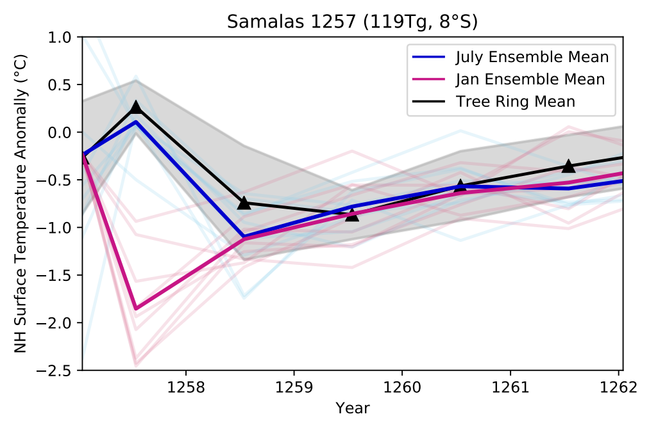
Key Result: - Combined tree ring and model constraints strongly favor a summer 1257 date for the Samalas Eruption. See my poster for more!
Results
Tree Ring data: from Wilson et al., (2016), Schneider et al., (2015), Anchukaitis et al., (), Guillet et al., (2017)
Constraining the Timing of the 1257 Samalas Eruption: a Model and Multi-proxy Approach lw602@cam.ac.uk
Notes:
The plot shows the NH land SAT anomaly, with the blue and pink lines show the July and January ensemble means respectively. The black line shows the mean for 4 NH tree ring chronologies.
You can see that the July mean matches well with the tree ring data, whilst the peak cooling is significantly too early and too extreme for a January eruption. So this is our first piece of evidence to be able to constrain the timing of the eruption which appears to favour summer 1257. If you’re interested please come and see my poster, and I’ll be able to talk you through how we’re also using a spatially resolved tree ring data set and stalagmite records to investigate this further Thank you for listening!

